Slide 1
Lecture 19: Case Study: An Implementation of Cortex-M3 – the LM3S9B96

Slide 2
Stellaris® LM3S9B96 Microcontroller
Data Sheet
Chapter 1
Architectural Overview

Slide 3
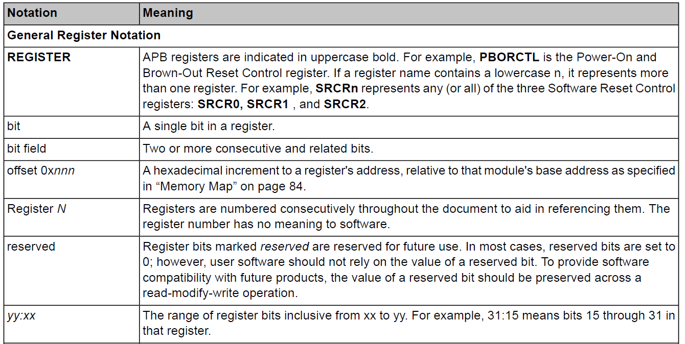
Documentation Conventions

Slide 4
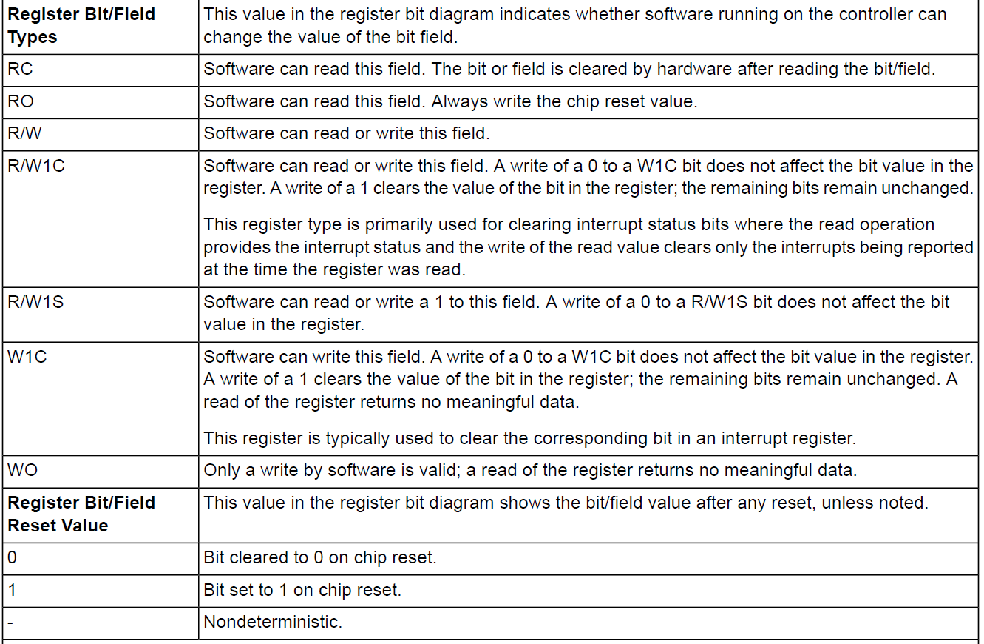
Documentation Conventions

Slide 5
The LM3S9B96 microcontroller
Made by Texas Instruments
Stellaris is a microcontroller family based on ARM Cortex-M3 and the Thumb-2 instruction set
The LM3S9B96 microcontroller has the following features:
  ARM® Cortex™-M3 Processor Core
  On-Chip Memory
  External Peripheral Interface (EPI)
  Advanced Serial Integration
  System Integration
  Advanced Motion Control
  Analog
  JTAG and ARM Serial Wire Debug (SWD)
  100-pin LQFP and 108-ball BGA package
  Industrial (-40°C to 85°C) Temperature Range

Slide 6
ARM Cortex™-M3
Processor Core
32-bit ARM® Cortex™-M3 v7M architecture
Outstanding processing performance combined with fast interrupt handling
Thumb-2 mixed 16-/32-bit instruction set: high performance in a compact memory size
  Single-cycle multiply instruction and hardware divide operation
  Atomic bit manipulation (bit-banding)
  Unaligned data access
Harvard architecture: separate buses for instruction and data
Deterministic, high-performance interrupt handling for time-critical apps.
Enhanced system debug with extensive breakpoint and trace capabilities
Ultra-low power consumption with integrated sleep modes
80-MHz operation, 100 DMIPS performance

Slide 7
ARM Cortex™-M3
System Timer (SysTick)
provides a simple, 24-bit, clear-on-write, decrementing, wrap-on-zero counter
The counter can be used in several ways:
  An RTOS tick timer that fires at a programmable rate and invokes a SysTick exception handler
  A high-speed alarm timer using the system clock
  A variable rate alarm or signal timer
  A simple counter used to measure time to completion and time used
  An internal clock-source control based on missing/meeting durations, via checking the COUNTFLAG field in the SysTick Control and Status register.

Slide 8
ARM Cortex™-M3
Nested Vectored Interrupt Controller (NVIC)
All exceptions are handled in Handler Mode
Automatic stacking and unstacking of the processor state on an exception
Vectored: efficient interrupt entry
Nested: eight priority levels on 7 exceptions (system handlers) and 53 interrupts
Deterministic, fast interrupt processing: always 12 cycles, or just 6 cycles with tail-chaining
NMI

Slide 9
On-Chip Memory
SRAM
The LM3S9B96 microcontroller provides 96 KB of single-cycle on-chip SRAM, located at offset 0x2000.0000
A bit-band region in SRAM
Data can be transferred to and from SRAM using the Micro Direct Memory Access Controller (μDMA)
Flash Memory
The LM3S9B96 microcontroller provides 256 KB of single-cycle on-chip Flash memory
Organized as a set of 2-KB blocks
  Data can be erased in the unit of block
  Different levels of code protection: read-only, execute-only (read by instruction fetch mechanism)

Slide 10
On-Chip Memory
ROM
The LM3S9B96 ROM is preprogrammed with the following software and programs:
  Stellaris Peripheral Driver Library: performs both peripheral initialization and control functions
  Stellaris Boot Loader
  SafeRTOS™ preemptive real-time kernel
  Advanced Encryption Standard (AES) cryptography tables
  Cyclic Redundancy Check (CRC) error-detection functionality

Slide 11
External Peripheral Interface (EPI)
The External Peripheral Interface (EPI) provides access to external devices using a parallel path, like a bus
  8/16/32-bit dedicated parallel bus for external peripherals and memory
  Memory interface supports contiguous memory access independent of data bus width
  Separates processor from timing details through use of an internal write FIFO
  Efficient transfers using Micro Direct Memory Access Controller (μDMA)
  Supports three primary functional modes: SDRAM, Host-bus, and General Purpose

Slide 12
Serial Communications Peripherals
The LM3S9B96 controller supports both asynchronous and synchronous serial communications
  10/100 Ethernet MAC and PHY
  Two CAN 2.0 A/B Controllers
  USB 2.0 (full speed and low speed) OTG/Host/Device
  Three UARTs with IrDA and ISO 7816 support
  Two I²C modules
  Two Synchronous Serial Interface modules (SSI)
  Integrated Inter-chip Sound (I²S) Module

Slide 13
Serial Communications Peripherals
Ethernet Controller
Ethernet (IEEE 802.3) is a frame-based computer networking technology for local area networks (LANs)
Conforms to the IEEE 802.3-2002 specification
Multiple operational modes: Full-/half-duplex, 10/100Mbps
Highly configurable: MAC address, LED activity and etc.
Physical media manipulation
IEEE 1588 Precision Time Protocol for accurate time stamps of packets
Efficient transfers using μDMA

Slide 14
Serial Communications Peripherals
Controller Area Network (CAN): is a multicast shared serial-bus standard for connecting electronic control units (ECUs), designed to be robust in electromagnetically noisy environments (automotive, industrial or medical)
Bit rates 1Mbps at 40 meters
A transmitter sends a message to all CAN nodes (broadcasting), each node decides whether it should process the message based on the identifier received
The LM3S9B96 microcontroller includes two CAN units

Slide 15
Serial Communications Peripherals
Universal Serial Bus (USB): is a serial bus standard designed to allow peripherals to be connected and disconnected using a standardized interface without rebooting the system
The LM3S9B96 controller supports three configurations in USB 2.0 full (12 Mbps) and low speed (1.5 Mbps):
  USB Host
  USB Device
  USB On-The-Go: negotiated on-the-go as host or device when connected to other USB-enabled systems

Slide 16
Serial Communications Peripherals
Universal Asynchronous Receiver/Transmitter (UART):
The LM3S9B96 controller includes three fully programmable 16C550-type UARTs.
Key features:
  Programmable baud-rate generator
  Standard asynchronous communication bits for start, stop, and parity
  Fully programmable serial interface characteristics
  Full modem handshake support (on UART1)
  Efficient transfers using μDMA

Slide 17
Serial Communications Peripherals
The Inter-Integrated Circuit (I²C) bus: provides bi-directional data transfer through a two-wire design (a serial data line SDA and a serial clock line SCL).
Each device on the I²C bus supports both sending and receiving data as either a master or a slave
Both the I²C master and slave can generate interrupts
The LM3S9B96 controller includes two I²C modules with the following features:
  Four I²C modes: master/slave transmit/receive
  Two transmission speeds: Standard (100 Kbps) and Fast (400 Kbps)
  Master and slave interrupt generation
  Master with arbitration and clock synchronization, multi-master support, and 7-bit addressing mode

Slide 18
Serial Communications Peripherals
Inter-Integrated Circuit Sound (I²S) : is a configurable serial audio core that contains a transmit module and a receive module. Data can be in one of four modes: Stereo, Mono, Compact 16-bit Stereo and Compact 8-Bit Stereo.

Slide 19
System Integration
The LM3S9B96 controller provides a variety of standard system functions integrated into the device:
  Micro Direct Memory Access Controller (μDMA)
  System control and clocks including on-chip precision 16-MHz oscillator
  ARM Cortex SysTick Timer
  Four 32-bit timers (up to eight 16-bit)
  Three UARTs with IrDA and ISO 7816 support
  Eight Capture Compare PWM pins (CCP)
  Real-Time Clock
  Two Watchdog Timers
  Up to 65 GPIOs

Slide 20
System Integration
Direct Memory Access : provides a way to offload data transfer tasks from the Cortex-M3 processor, allowing for more efficient use of the processor and the available bus bandwidth by performing transfers between memory and peripherals.
ARM PrimeCell® 32-channel configurable μDMA controller
Support for memory-to-memory, memory-to-peripheral, and peripheral-to-memory
Data sizes of 8, 16, and 32 bits
Transfer size is programmable in binary steps from 1 to 1024
Maskable peripheral requests
Interrupt on transfer completion, with a separate interrupt per channel

Slide 21
System Integration
Direct Memory Access : provides a way to offload data transfer tasks from the Cortex-M3 processor, allowing for more efficient use of the processor and the available bus bandwidth by performing transfers between memory and peripherals.
ARM PrimeCell® 32-channel configurable μDMA controller
Support for memory-to-memory, memory-to-peripheral, and peripheral-to-memory
Data sizes of 8, 16, and 32 bits
Transfer size is programmable in binary steps from 1 to 1024
Maskable peripheral requests
Interrupt on transfer completion, with a separate interrupt per channel

Slide 22
System Integration
System Control and Clocks : determines the overall operation of the device, provides information about the device, controls power-saving features, controls the clocking of the device and individual peripherals, and handles reset detection and reporting.
Device identification information
Power control
Multiple clock sources for microcontroller system clock
Flexible reset sources

Slide 23
System Integration
Four Programmable Timers : Each General-Purpose Timer Module (GPTM) block provides two 16-bit timers/counters that can be configured to operate independently as timers or event counters, or configured to operate as one 32-bit timer or one 32-bit Real-Time Clock (RTC).
Key features:
  Count up or down
  16- or 32-bit programmable one-shot timer
  16- or 32-bit programmable periodic timer
  32-bit Real-Time Clock (RTC) when using an external 32.768-KHz clock as the input

Slide 24
System Integration
Capture Compare PWM pins (CCP) : can be used by the General-Purpose Timer Module to time/count external events using the CCP pin as an input; alternatively, the GPTM can generate a simple PWM output on the CCP pin.
The LM3S9B96 microcontroller includes eight Capture Compare PWM pins :
  Capture: The GP Timer is incremented/decremented by programmed events on the CCP input. The GP Timer captures and stores the current timer value when a programmed event occurs.
  Compare: CCP is the input of the GP Timer. The GP Timer compares the current value with a stored value and generates an interrupt when a match occurs.
  PWM: The GP Timer is incremented/decremented by the system clock. A PWM signal is generated based on a match between the counter value and a value stored in a match register and is output on the CCP pin.

Slide 25
System Integration
Watchdog Timers : is used to regain control when a system has failed due to a software error or to the failure of an external device to respond in the expected way. The Stellaris Watchdog Timer can generate an interrupt or a reset when a time-out value is reached.
The LM3S9B96 microcontroller has two Watchdog Timer modules:
  Watchdog Timer 0 uses the system clock for its timer clock
  Watchdog Timer 1 uses the PIOSC as its timer clock
  32-bit down counter with a programmable load register
  Programmable interrupt generation logic with interrupt masking
  Lock register protection from runaway software
  Reset generation logic with an enable/disable

Slide 26
System Integration
General-purpose input/output (GPIO) : offer flexibility for a variety of connections. The Stellaris GPIO module is comprised of nine physical GPIO blocks, each corresponding to an individual GPIO port, and supports 0-65 programmable input/output pins.
Key features:
  Up to 65 GPIOs, depending on configuration
  Highly flexible pin muxing
  Two means of port access: either Advanced High-Performance Bus (AHB) or the legacy Advanced Peripheral Bus (APB) for backwards-compatibility
  Programmable control for GPIO interrupts
  Bit masking in both read and write operations through address lines
  Reset generation logic with an enable/disable
  Programmable control for GPIO pad configuration

Slide 27
Advanced Motion Control
The LM3S9B96 controller provides motion control functions integrated into the device, including:
Key features:
  Eight advanced PWM outputs for motion and energy applications
  Two Quadrature Encoder Inputs (QEI)

Slide 28
Advanced Motion Control
Pulse width modulation (PWM): is a powerful technique for digitally encoding analog signal levels: High-resolution counters are used to generate a square wave, and the duty cycle of the square wave is modulated to encode an analog signal.
The LM3S9B96 PWM module consists of four PWM generator blocks:
  Four fault input to promote low-latency shutdown
  One 16-bit counter
  Two PWM comparators
  PWM signal generator
  Dead-band generator
One control block determines the polarity of the PWM signals and which signals are passed through to the pins.

Slide 29
Analog
The LM3S9B96 controller provides analog functions integrated into the device
  Two 10-bit Analog-to-Digital Converters (ADC) with sixteen analog input channels and sample rate of one million samples/second
  Three analog comparators
  16 digital comparators
  On-chip voltage regulator

Slide 30
JTAG and ARM Serial Wire Debug
The Joint Test Action Group (JTAG) : is an IEEE standard that defines a Test Access Port and Boundary Scan Architecture for digital integrated circuits and provides a standardized serial interface for controlling the associated test logic.

Slide 31
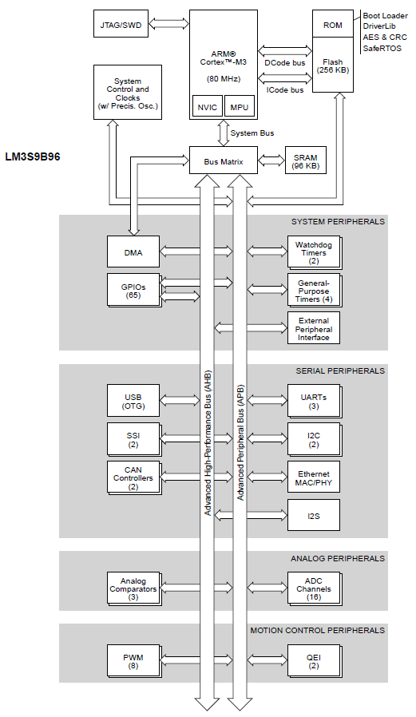
High-Level Block Diagram

